Slide 2
Exploratory Analysis

Slide 3
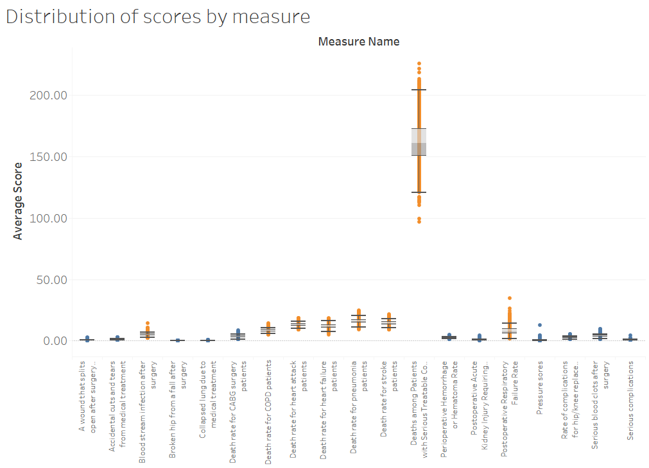

Slide 4
